Slide 1
Garbage Organizer
By:
Poria Ebrahimi
Uttam Indukuri

Slide 2
About Our Program
We decide to partake in the JP Morgan Chase Challenge because we wanted to create something that would benefit and educate society.
Our game gives the user a number of objects each with differing masses and materials and the user must decide if they are recyclable or trash. The user uses their finger to fling the objects.

Slide 3
Program Details
To begin, we created a list of things our program needed to do.
We began working by creating the given shapes and the ground.
We then worked to program the code that determined whether or not the trash/recyclables were in the correct garbage bin.
When ever the player successfully throws the correct object into the corresponding bin, the user scores one point.

Slide 4
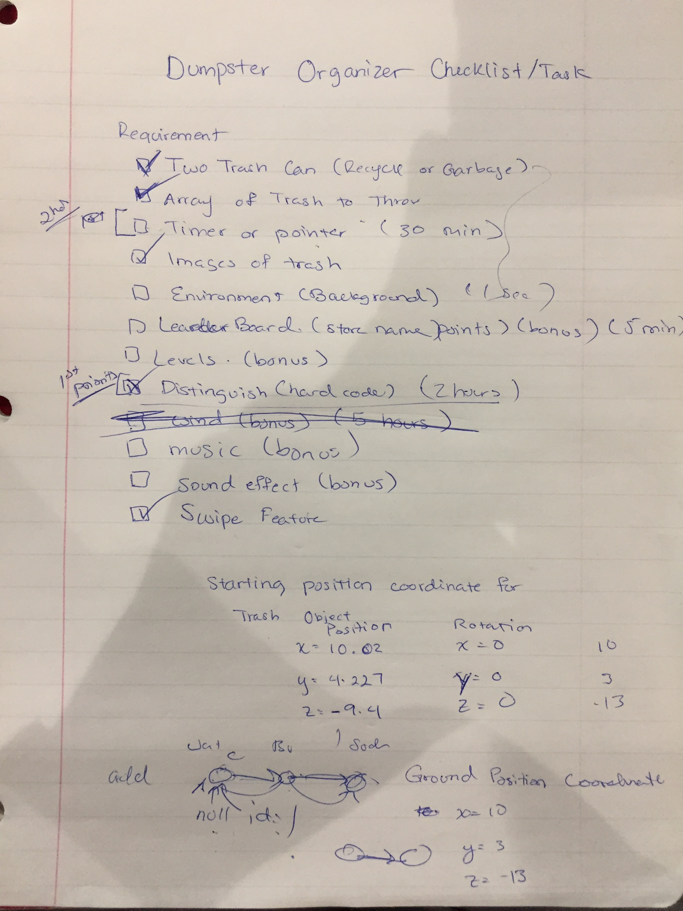
Our List
We accomplished the main aspects of our program, but time limit and some problems that we faced, didn’t allow us to meet all of our goals.
The Point of our program was to teach people about recycling in a fun way and we were able to successfully implement that in the limited time.

Slide 5
Some Problems
We faced 2 major problems during our time in HackUTD.
First we had troubles creating the array of objects in Unity, but later figured it out.
We also had some problems with the collisions, but decided to change our method.
This was also both of our first times using Unity and C# for a real project and had to self-teach many of the interfaces and functionalities.

Slide 6

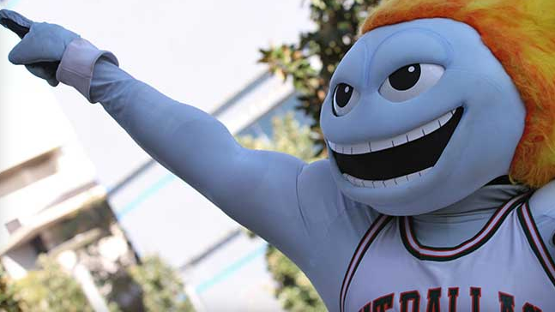



Thank You
We hope you enjoy our game.

